Slide 1

Data-Driven Insights for Digital Marketing Campaigns

Slide 2
Problem statement:
Digital marketing campaigns often lack data-backed decisions, leading to inefficiencies, poor ROI, and limited audience engagement. This project solves that using data analysis and visual insights.

Slide 3
Project Overview
Objective: To analyze digital marketing campaign data, identify key performance trends, and generate actionable insights to improve ROI.
Tools Used: Excel for data cleaning and KPIs, Power BI for dashboard, documentation for strategy

Slide 4
Data Preprocessing
To perform data cleaning process: Verified for any potential duplicate records — none were found.
Checked all columns for missing values, Removed and replaced dashes (–) and blanks with 0 for calculation consistency, ensuring clean input for further analysis
Standardized all numeric columns and removed unnecessary column
Converted engagement time (1m 15s) to total seconds for accurate analysis
Renamed columns with broken headers (e.g., Key events All events...) for Power BI compatibility

Slide 5
KPI Identification & Benchmarks
KPIs were identified because they reflect engagement quality, ad effectiveness, cost control, and profitability — covering all core aspects & providing a 360° view of campaign performance across platforms.
Conversion Rate (%) Measures how many engaged sessions resulted in meaningful actions. High conversion indicates engaged, targeted traffic
Click-Through Rate (CTR) Measures how often users clicked on ads after seeing them. Benchmark: 2%–5% considered healthy
Cost Per Click (CPC) Tracks the average cost spent for each click. Lower CPC means better budget efficiency
Return on Investment (ROI) Measures campaign profitability relative to cost. Benchmark: ROI > 100% is ideal

Slide 6
Data Accuracy & Validation
Identified anomalies like Key Events > 0 but Engaged Sessions = 0, indicating possible tracking issues (e.g., in Paid Search)
Retained such rows but called them out in insights to maintain transparency
To generate meaningful insights, the data was thoroughly validated to eliminate inconsistencies and ensure accuracy across all metrics.

Slide 7
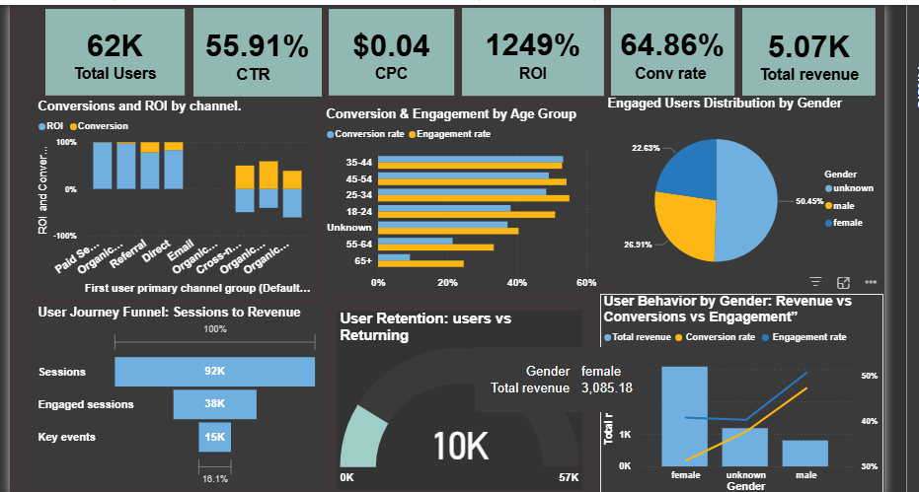
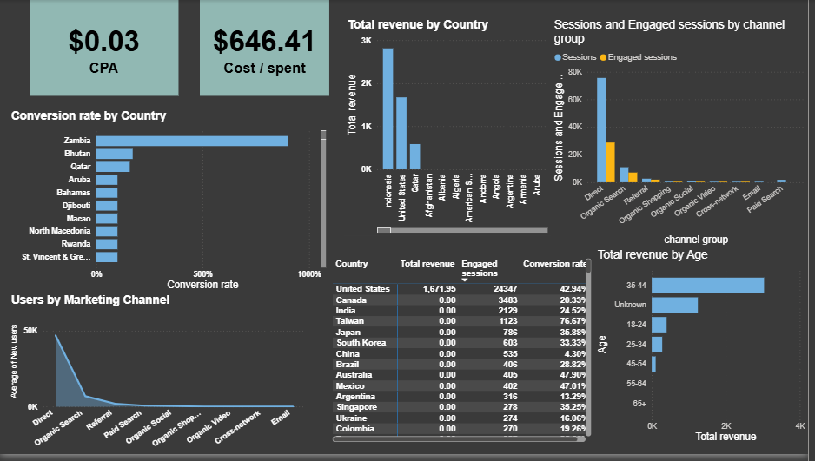
Digital Marketing Dashboard – Power BI Overview

Slide 8
Insight Generation
Key Insights: Campaign is delivering strong returns at low cost the below KPI metrics shows excellent efficiency in turning traffic into sales
Suggestion : Maintain budget focus on top-performing channels and demographics to scale sales profitably
Organic search is the top performing channel followed by referral which has high conversion rate and ROI
Top-Performing Segments
The age group 35–44 generates the highest revenue ($3,033.79) with a strong conversion rate (53.25%) and solid engagement — making them the most valuable audience segment
Gender distribution :
While female users drive the most revenue, male users are more engaged and convert better indicating a need to improve conversion journeys for female users and boost order value for male users
CPA: $0.03 (very low) | Conversion Rate: 64.86%
CTR: 55.91% | ROI: 1249% (extremely high)

Slide 9
Conversion Journey Drop-off
Only 16% of total sessions converted to revenue. Massive drop from sessions (92K) → key events (15K) → Total revenue ($5K).
User Retention is Low Out of 62K total users, only 10K were returning users a return rate of just indicating low ongoing engagement and loyalty.
Country-wise Performance
United States has many visitors and brings in money — good balance! Indonesia and Qatar showed high revenue and ROI with smaller user bases — great for targeted campaigns.

Slide 10
Key Recommendations:
Organic Search leads in both conversion (72%) and revenue ($2.8K)
Action:
Increase investment in SEO
Create more content around top-converting keywords
Out of 735 add-to-carts, only 202 reached checkout, and just 18 completed purchase → Huge drop at checkout-to-purchase stage.
Action:
Simplify checkout, trigger exit-intent offers, enable guest purchase, fix payment issues.
Implement exit-intent popups or retargeting ads
Growth Potential Segment: 25–34 group has strong engagement and good conversion. With a bit more effort, this can bring in high revenue
Action :
Focus paid ads and email campaigns on 25–44 age group with tailored messages (career-focused, financial freedom, lifestyle).

Slide 11
Hidden Gold Mines Countries like Sri Lanka, Venezuela, Kazakhstan are doing well with small numbers.
Action :
We should try to bring more people from these countries — they’re ready to buy!
Homepage Drives Bulk Traffic (/ )has 67,099 sessions and $1,390.45 revenue — the top-performing page. But Avg. Engagement Time is just 7s, meaning users are bouncing quickly.
Action:
Rework homepage banners and CTAs to direct visitors deeper into the funnel (product pages, featured offers, etc.).
A/B test layout to boost click-through.
High Engagement but No Revenue Pages like: /product/chrome-dino-googler-accessory-pack (2,646 key events, 14s) & /product/google-ripl-forest-green-bottle (1,129 key events, 8s) No conversions despite high user interaction.
Action :
These users are likely interested but not converting investigate checkout process and pricing.
Scarcity tactics ("Only 3 left!")

Slide 12
Summary
The campaign performance reveals strong CTR and ROI, yet highlights key drop-off points in the user journey. With refined targeting, budget-efficient acquisition, and landing page optimization, These insights can directly improve our campaign efficiency, reduce drop-offs, and boost sales.
The analysis highlights a critical gap between user intent and purchase behavior. By optimizing the checkout experience and retargeting high-engagement segments, we can significantly increase conversions
➡️ Smart spending ➡️ Funnel improvements ➡️ Audience-focused strategy

Slide 13

Thank you

